Slide 1

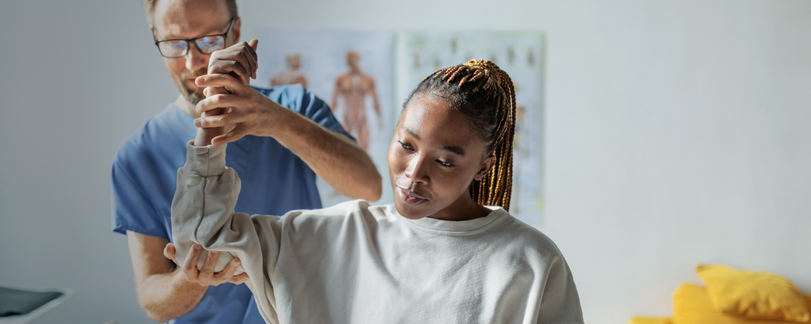


Join the Best. Be the Best.
Grow Your PT Career & Make a Meaningful Impact as a Physical Therapist in Lakeport, CA!
Whether you’re an experienced PT or just starting your career, you’ll find the support, mentorship and opportunities to grow your skills, all in a close-knit community surrounded by beautiful lake and mountain views, nearby wine country and endless outdoor adventure. Check out what it's like to live and work in Lakeport!
PT opportunities available in a Home Health setting.
Potential sign-on bonus of up to $10,000!
Location may qualify for public loan forgiveness programs (based on site eligibility and funding).
Monday – Friday schedule with your weekends free to explore!
What You’ll Do 🏃‍♂️
Evaluate, plan and deliver rehab programs to improve mobility, strength and patient function in a home health setting.
Provide patient-centered care supporting recovery from illness, injury or surgery.
Collaborate effectively with patients, families and interdisciplinary teams.
Who We're Looking For 🔍
Graduate of an accredited PT program
CA PT license (or eligible/in progress)
BLS certification
Passion for providing compassionate patient care in the home
We Offer:
Competitive Pay
Generous Benefits to Support Your Health and Wellness
403(b) Retirement Plan to Build Your Future
Employee Assistance Program for Life’s Challenges
Tuition Reimbursement to Support Your Development
Supportive, Collaborative Team
Mentorship & Career Development
Click here to apply:
R-137363: PT II, Lakeport, CA
Email for more info:
julie.caldwell@
sutterhealth.org
Sutter Health is an equal opportunity employer EOE/M/F/Disability/Veterans

