Slide 1
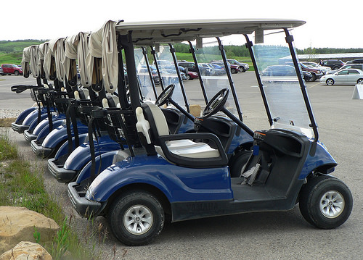
Golf Cart Safety Training

Slide 2
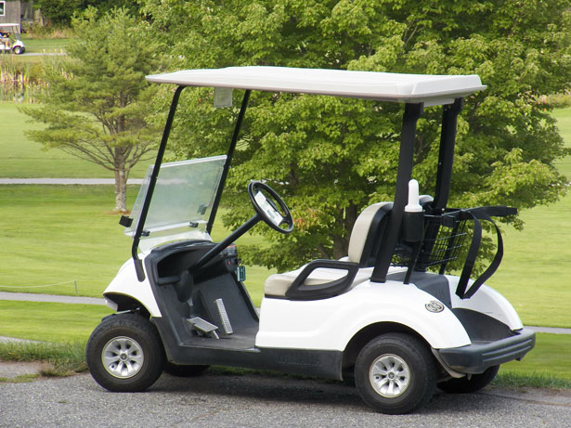
Topics to Cover
What are the golf carts used for on campus?
Accidents & Injuries
Safety Tips
Do’s/Don’ts with golf carts
Inspecting golf carts
Non-licensed vehicle operation and safety guidelines

Slide 3
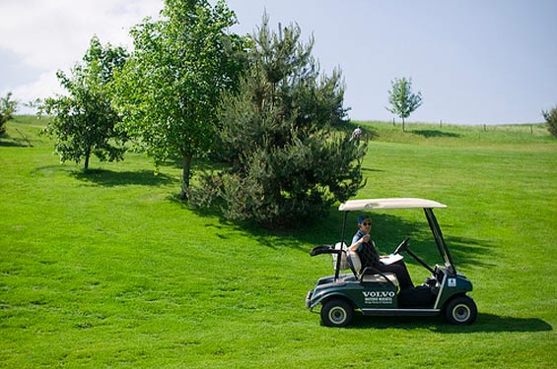
Where on campus do we use golf carts?
Golf carts are now utilized for a variety of purposes:
Delivery for catering, set ups and moves, custodial supply delivery, grounds, maintenance, mechanical, electrical, security, technology services, dining conference services

Slide 4
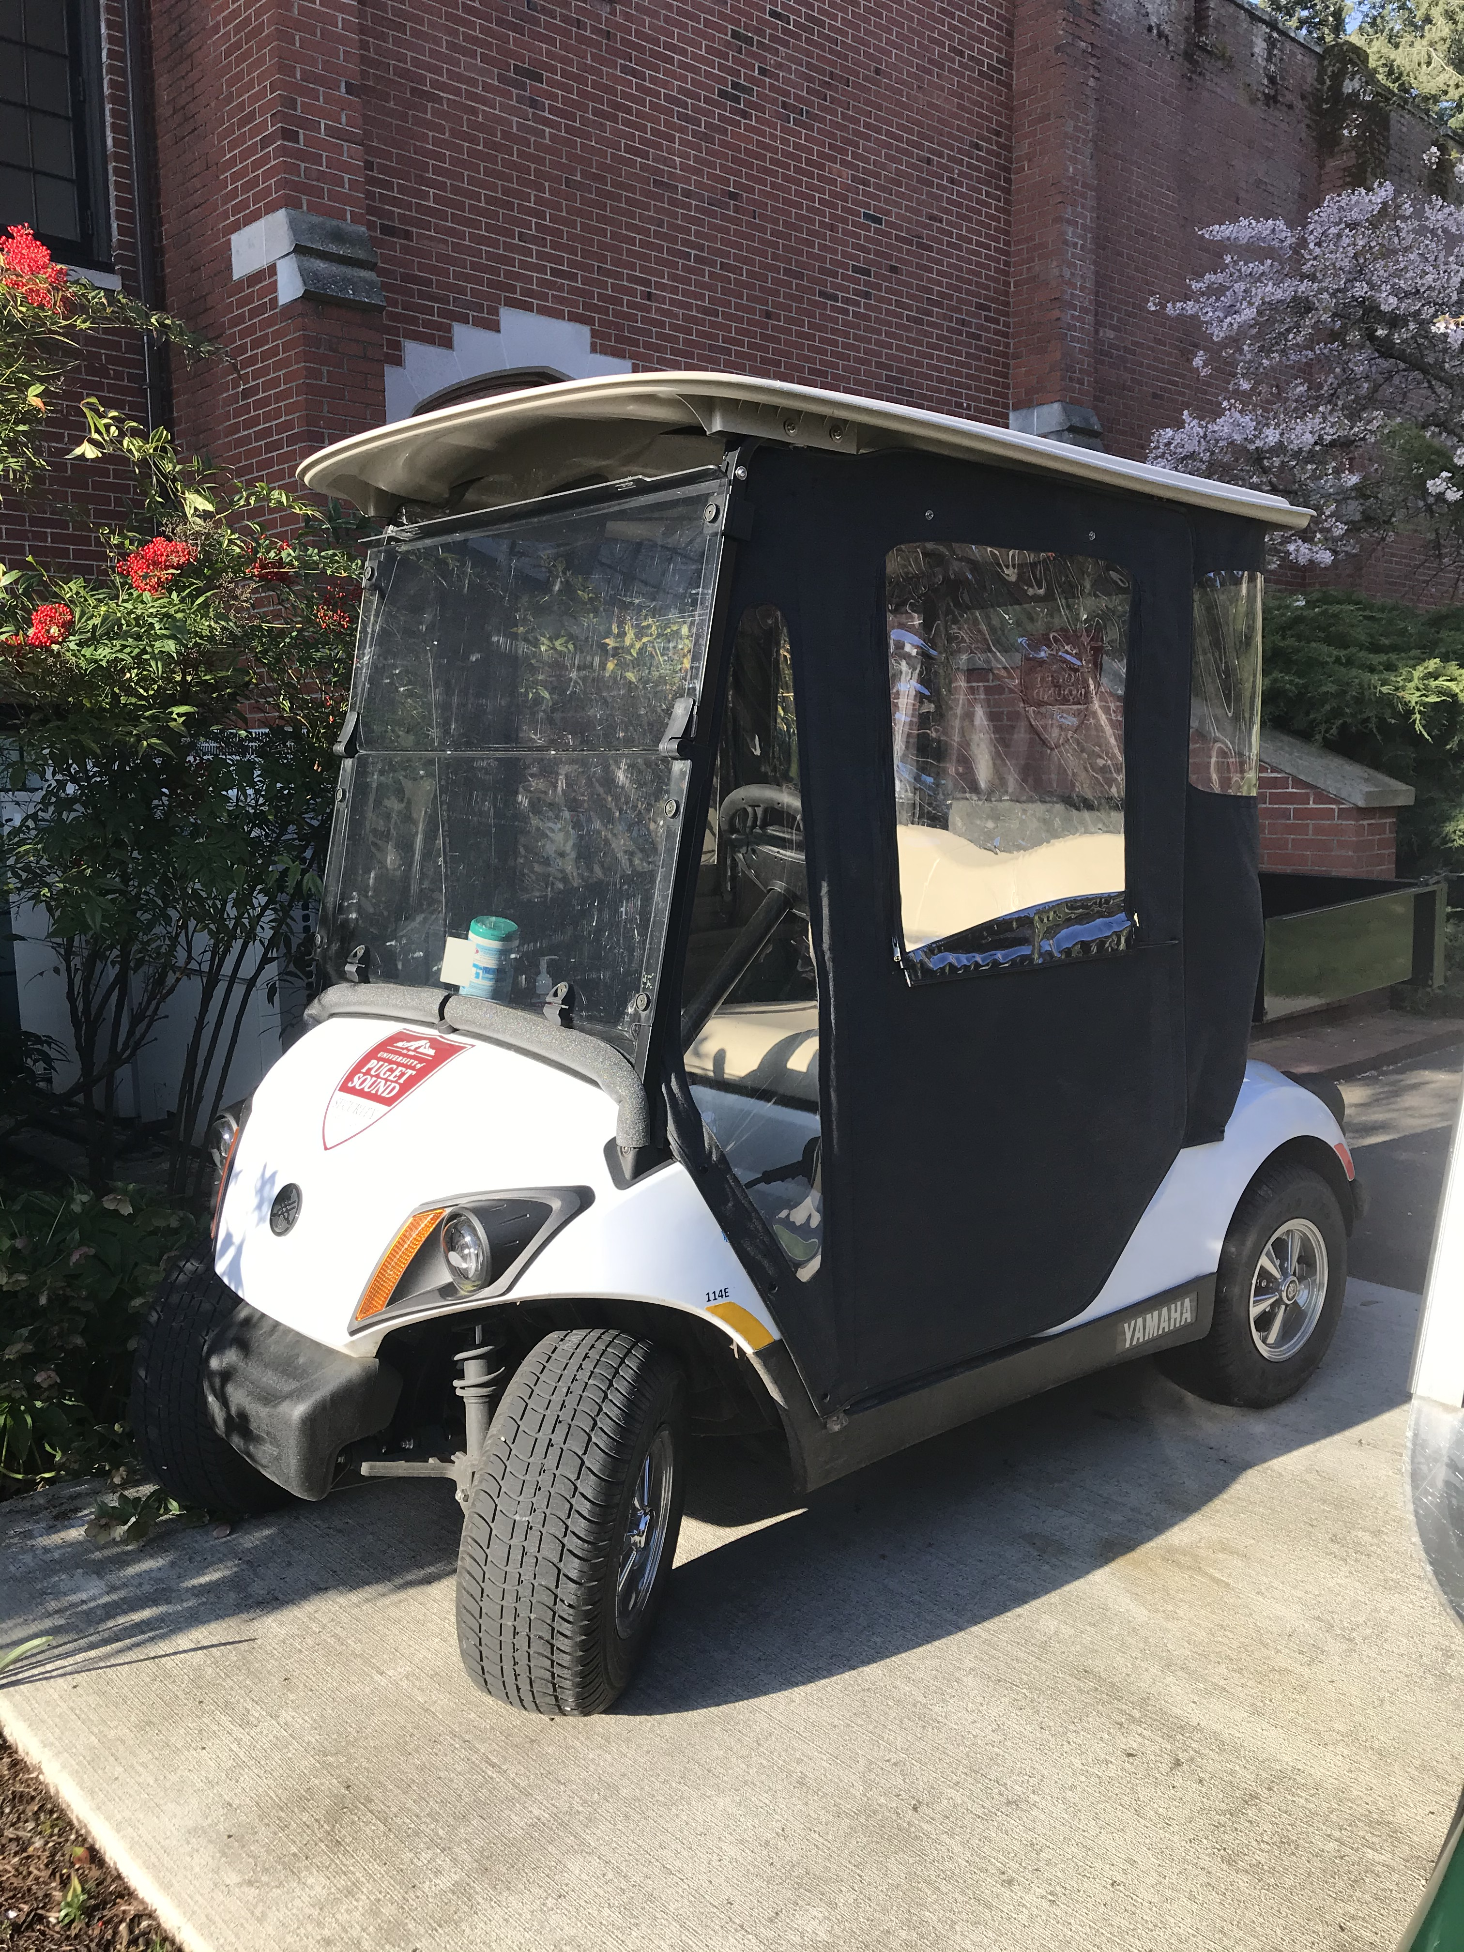
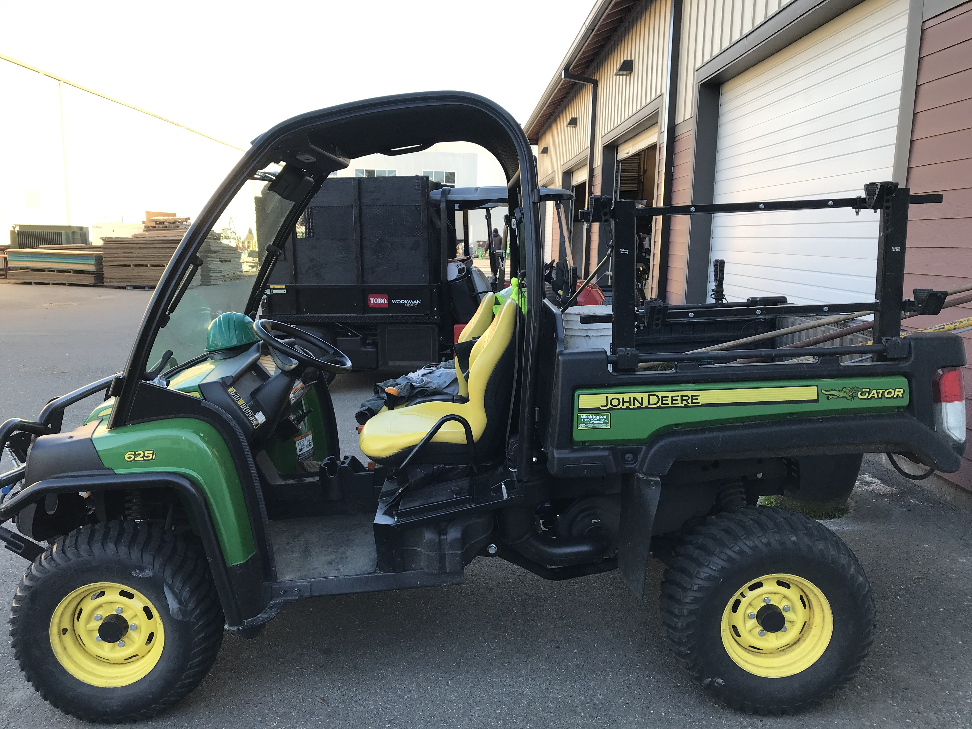
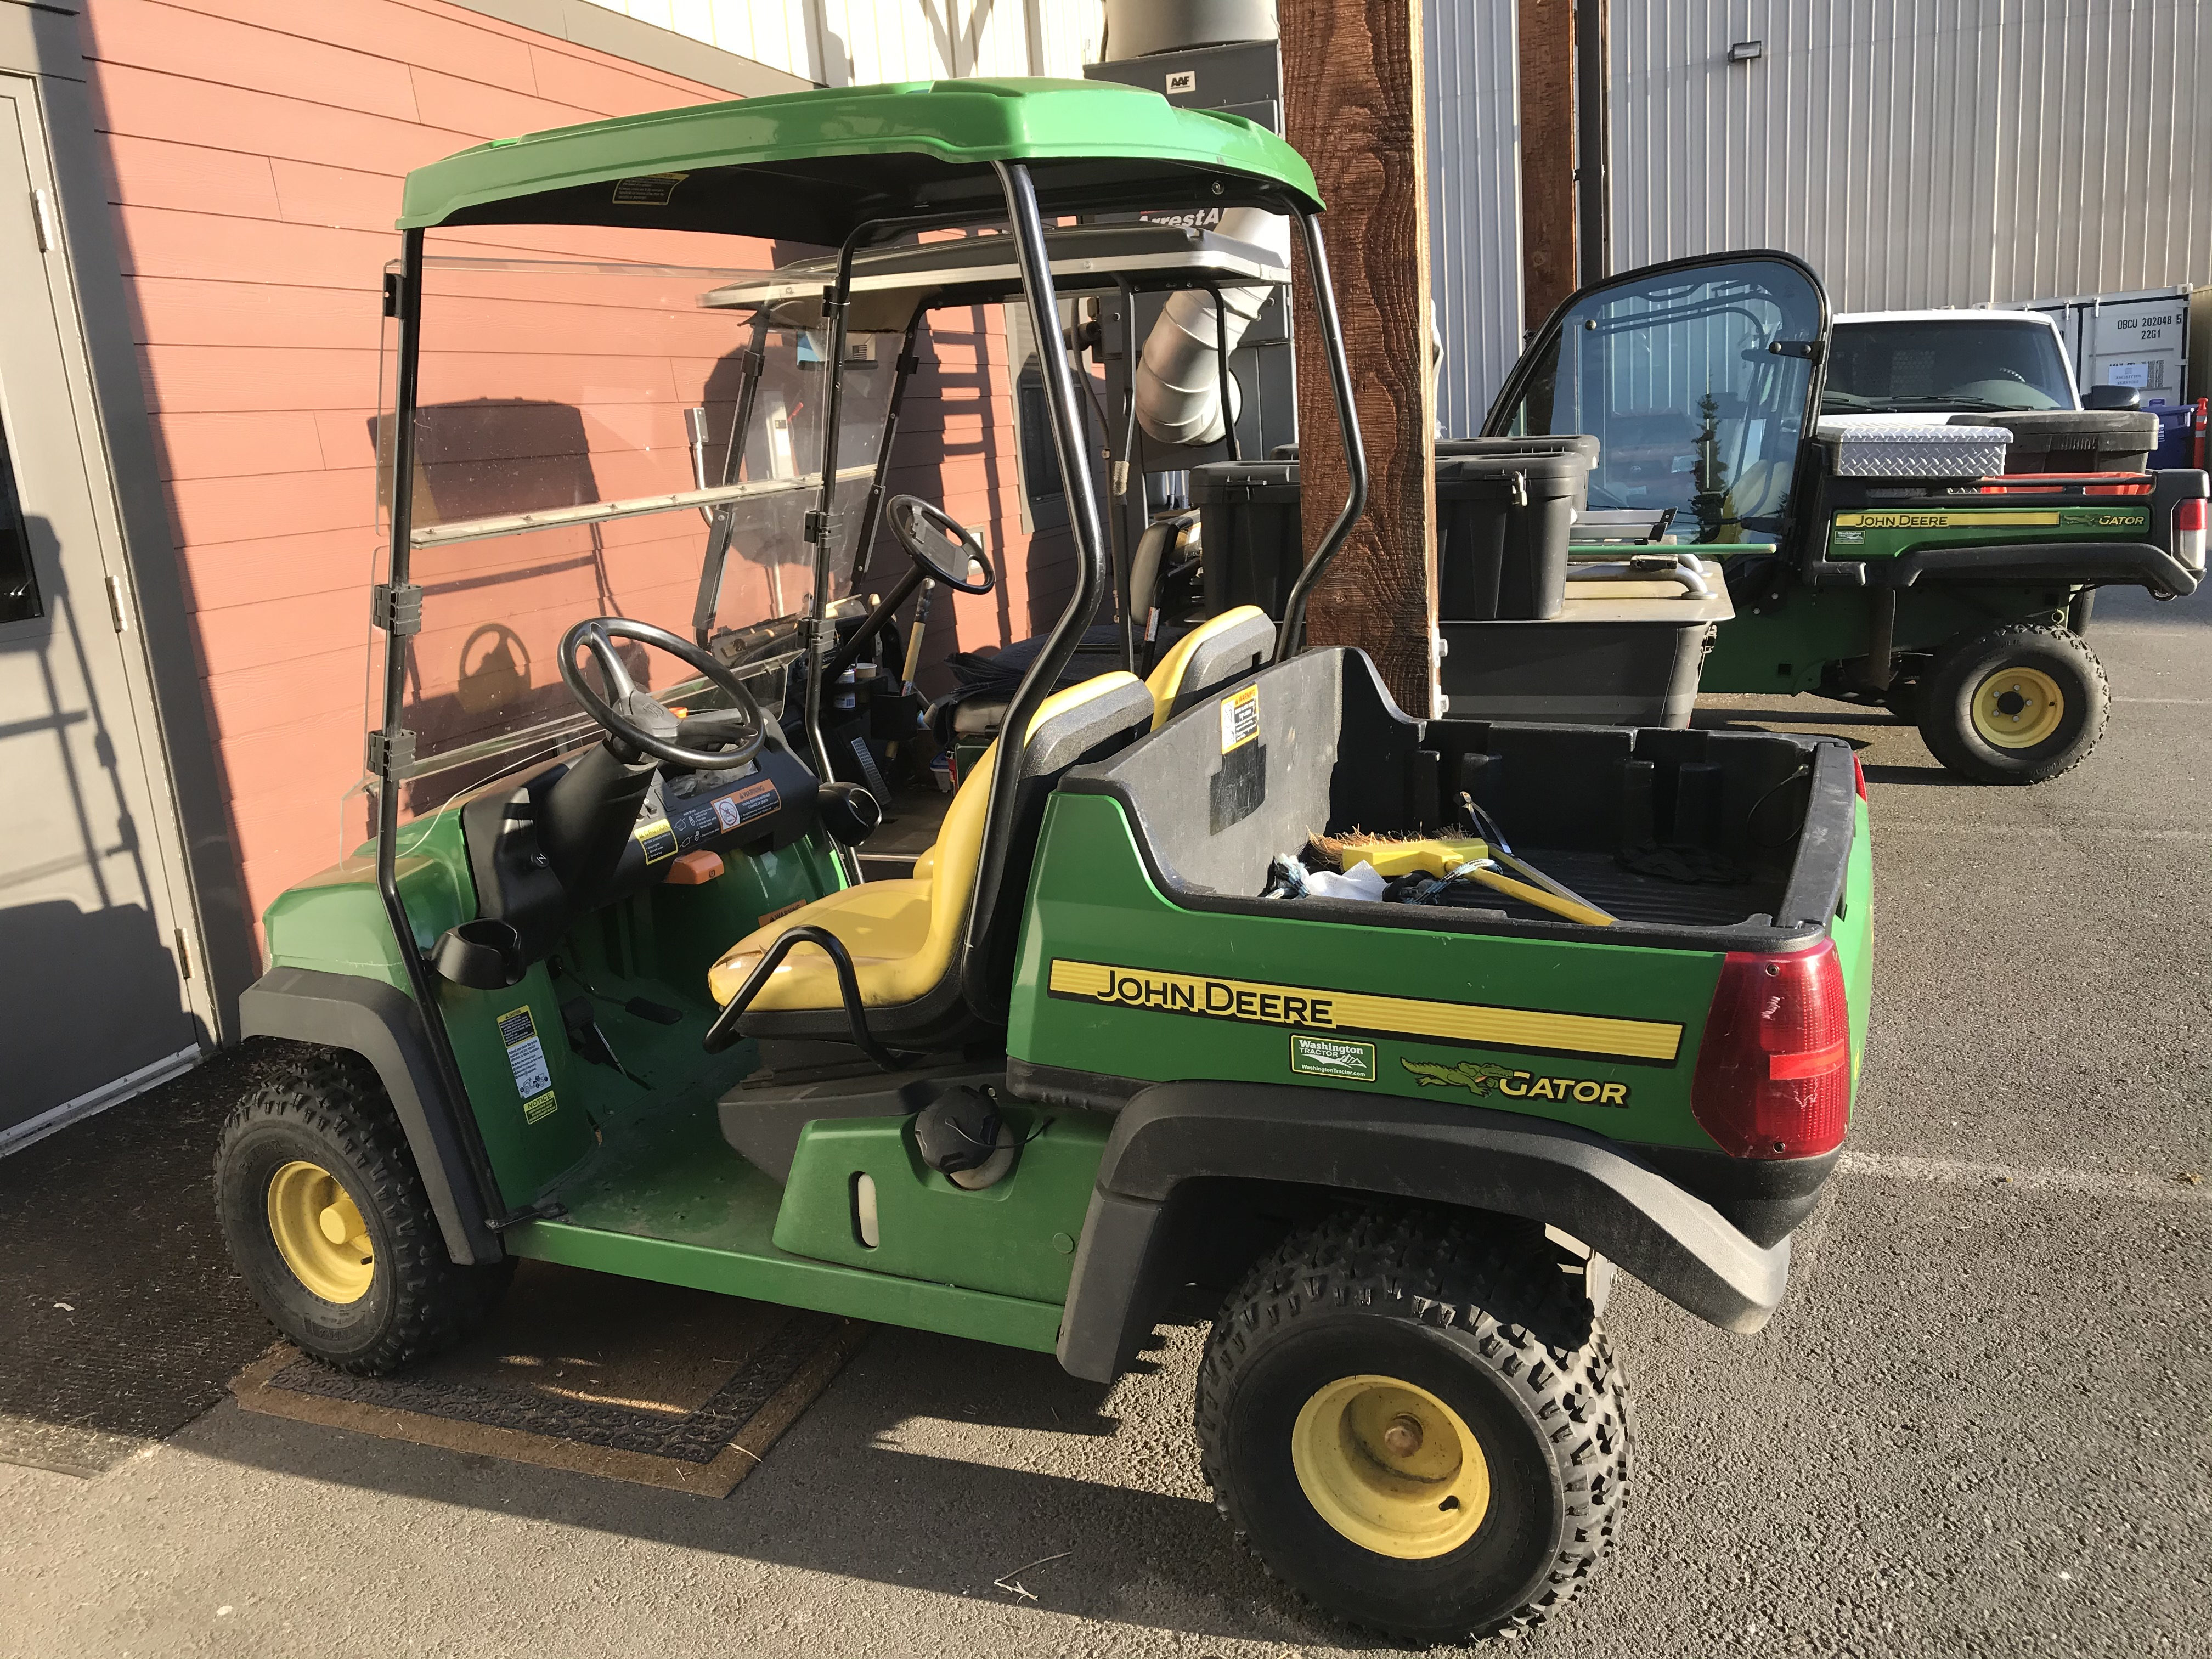
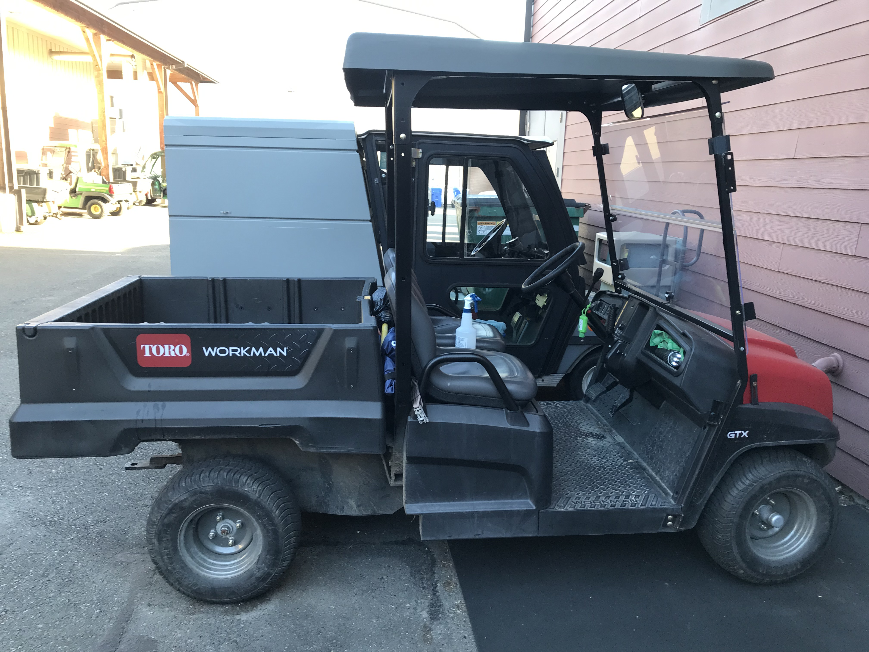
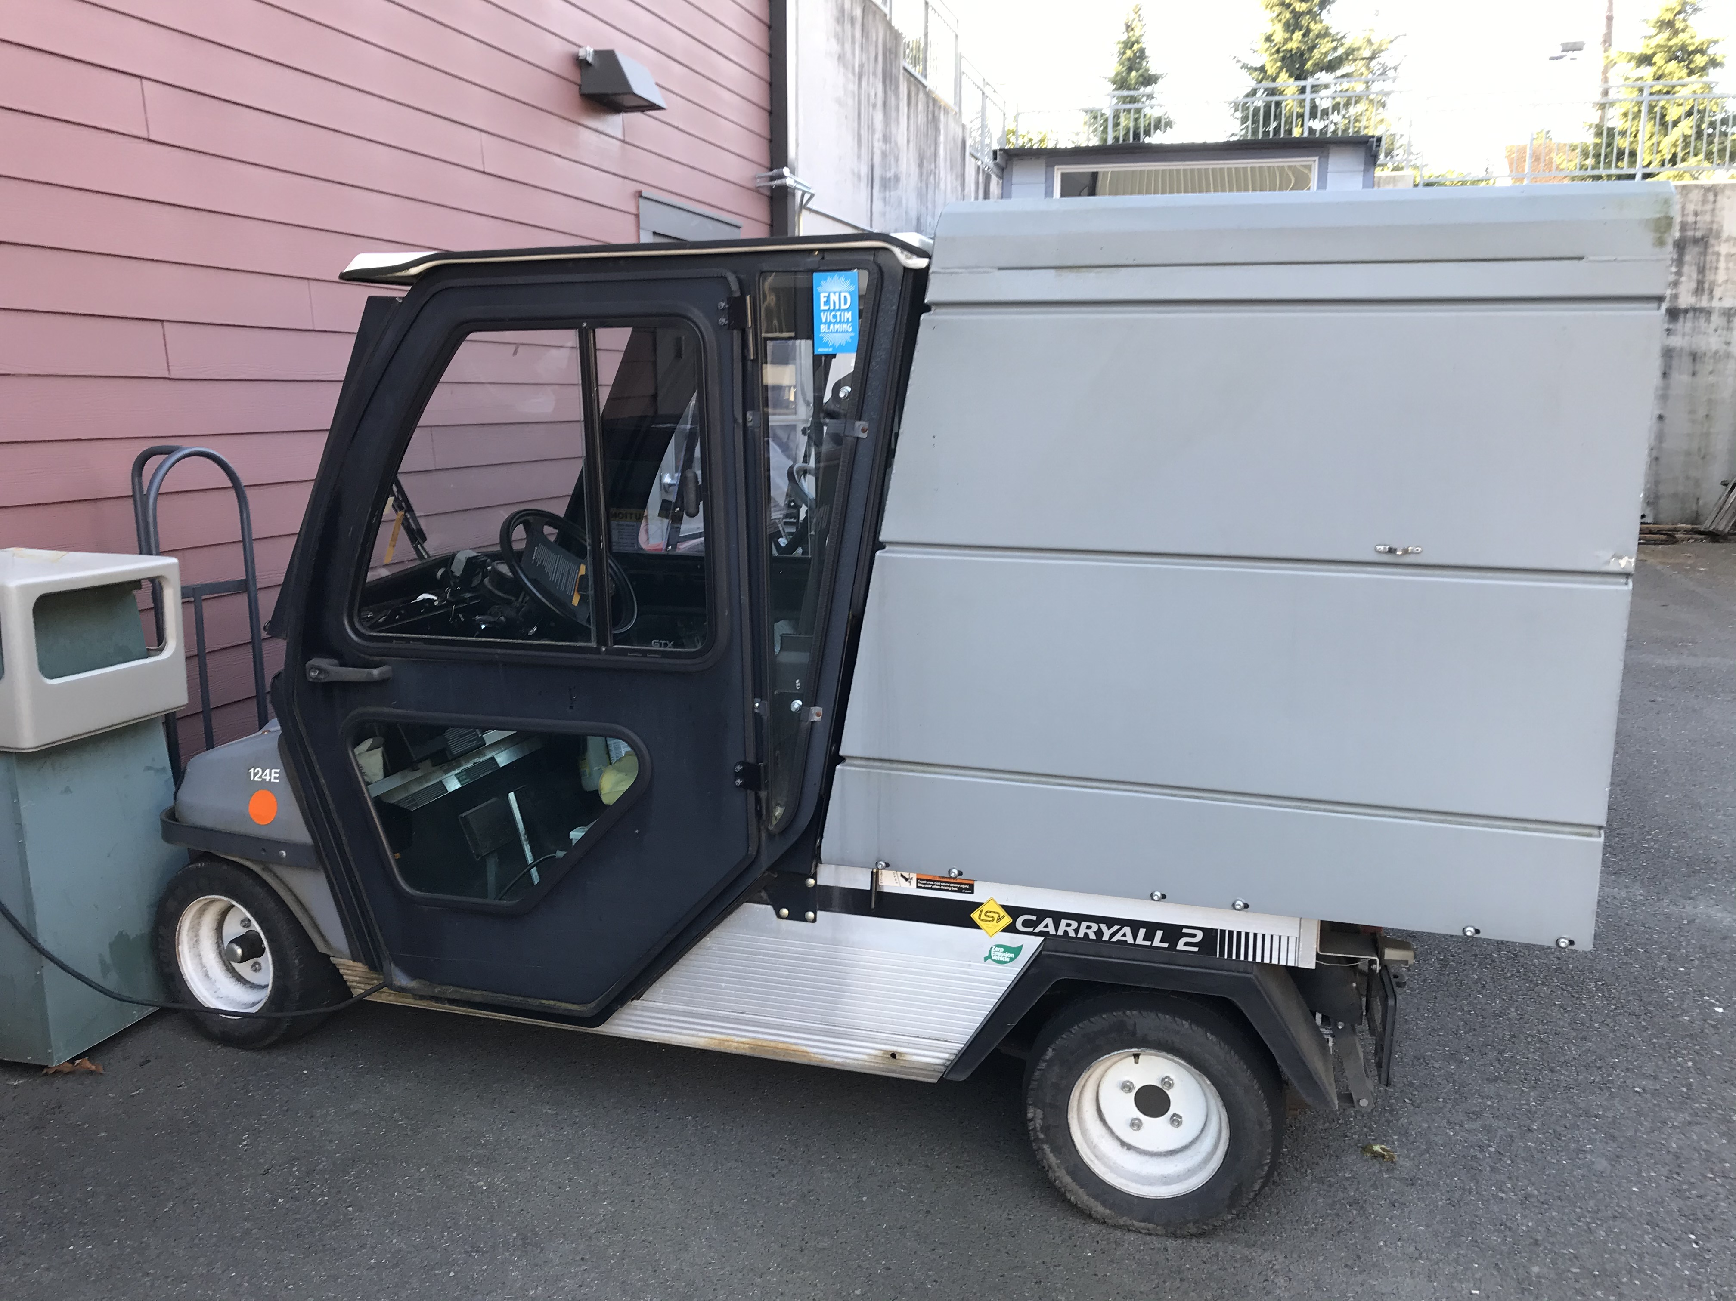
Golf carts on campus
Long-bed electric cart
Grounds gator
Mini gator
Security cart
Toro
Electric utility cart

Slide 5
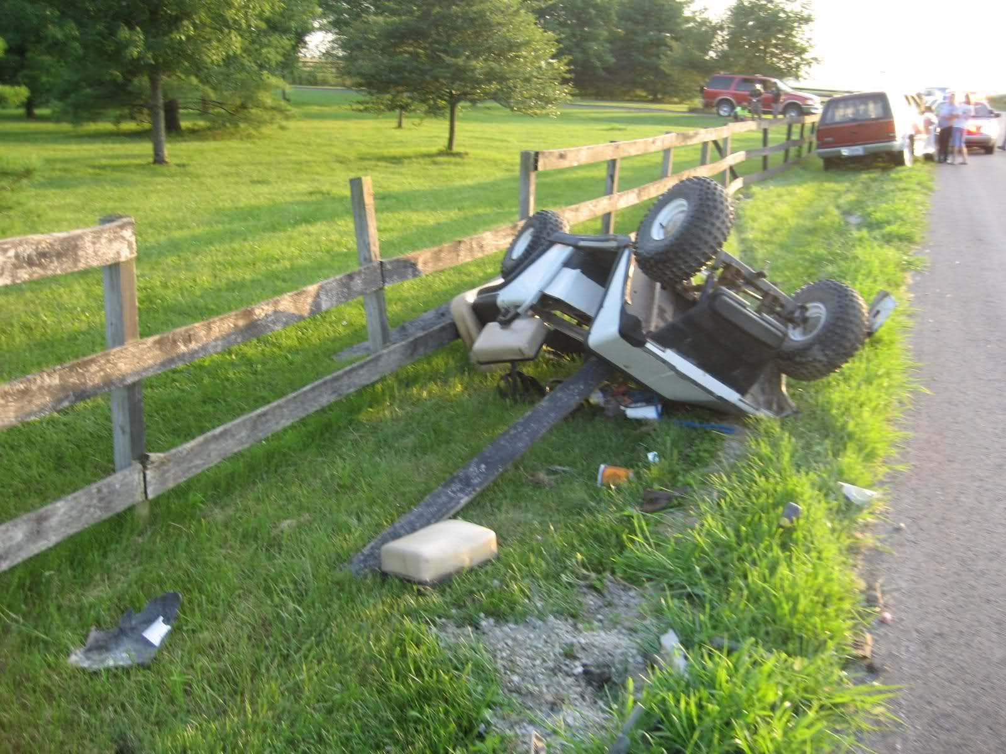
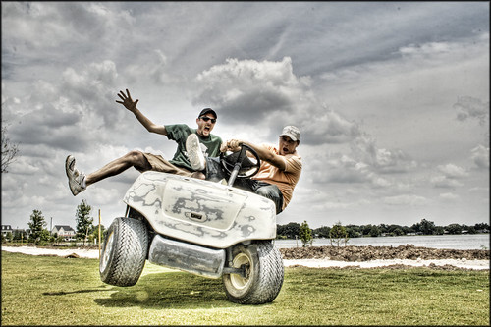
Accidents and Injuries
Golf carts can be versatile, however if they are used improperly, they can be dangerous
Common incidents are: overturning the cart, objects being struck, etc.

Slide 6
Safety Tips
ALWAYS give bicyclists, pedestrians, and motorists the right of way
Pay close attention at the points in which you are to cross public streets
No more passengers than what the cart is designed for (no one allowed to ride in the back of the cart)
Driver/passenger must keep hands, arms, legs, feet inside of the cart while moving
Reduce speed to compensate for declines, pedestrians, blind spots

Slide 7
Safety Tips
Do not allow more than two people to ride in vehicles front seats
Treat blind corners as an uncontrolled intersection
Do not use cell phones while driving
Never exit a cart while it is in motion

Slide 8
Seat Belts
If there is a seat belt in your cart, you MUST wear it
If there are any other safety equipment in the cart, you must use it

Slide 9
Pull off to the side slowly and wait for bicyclists and pedestrians to pass by

Slide 10
Slow down and be extra attentive while near blind spots on campus
Facilities Parking Lot

Slide 11
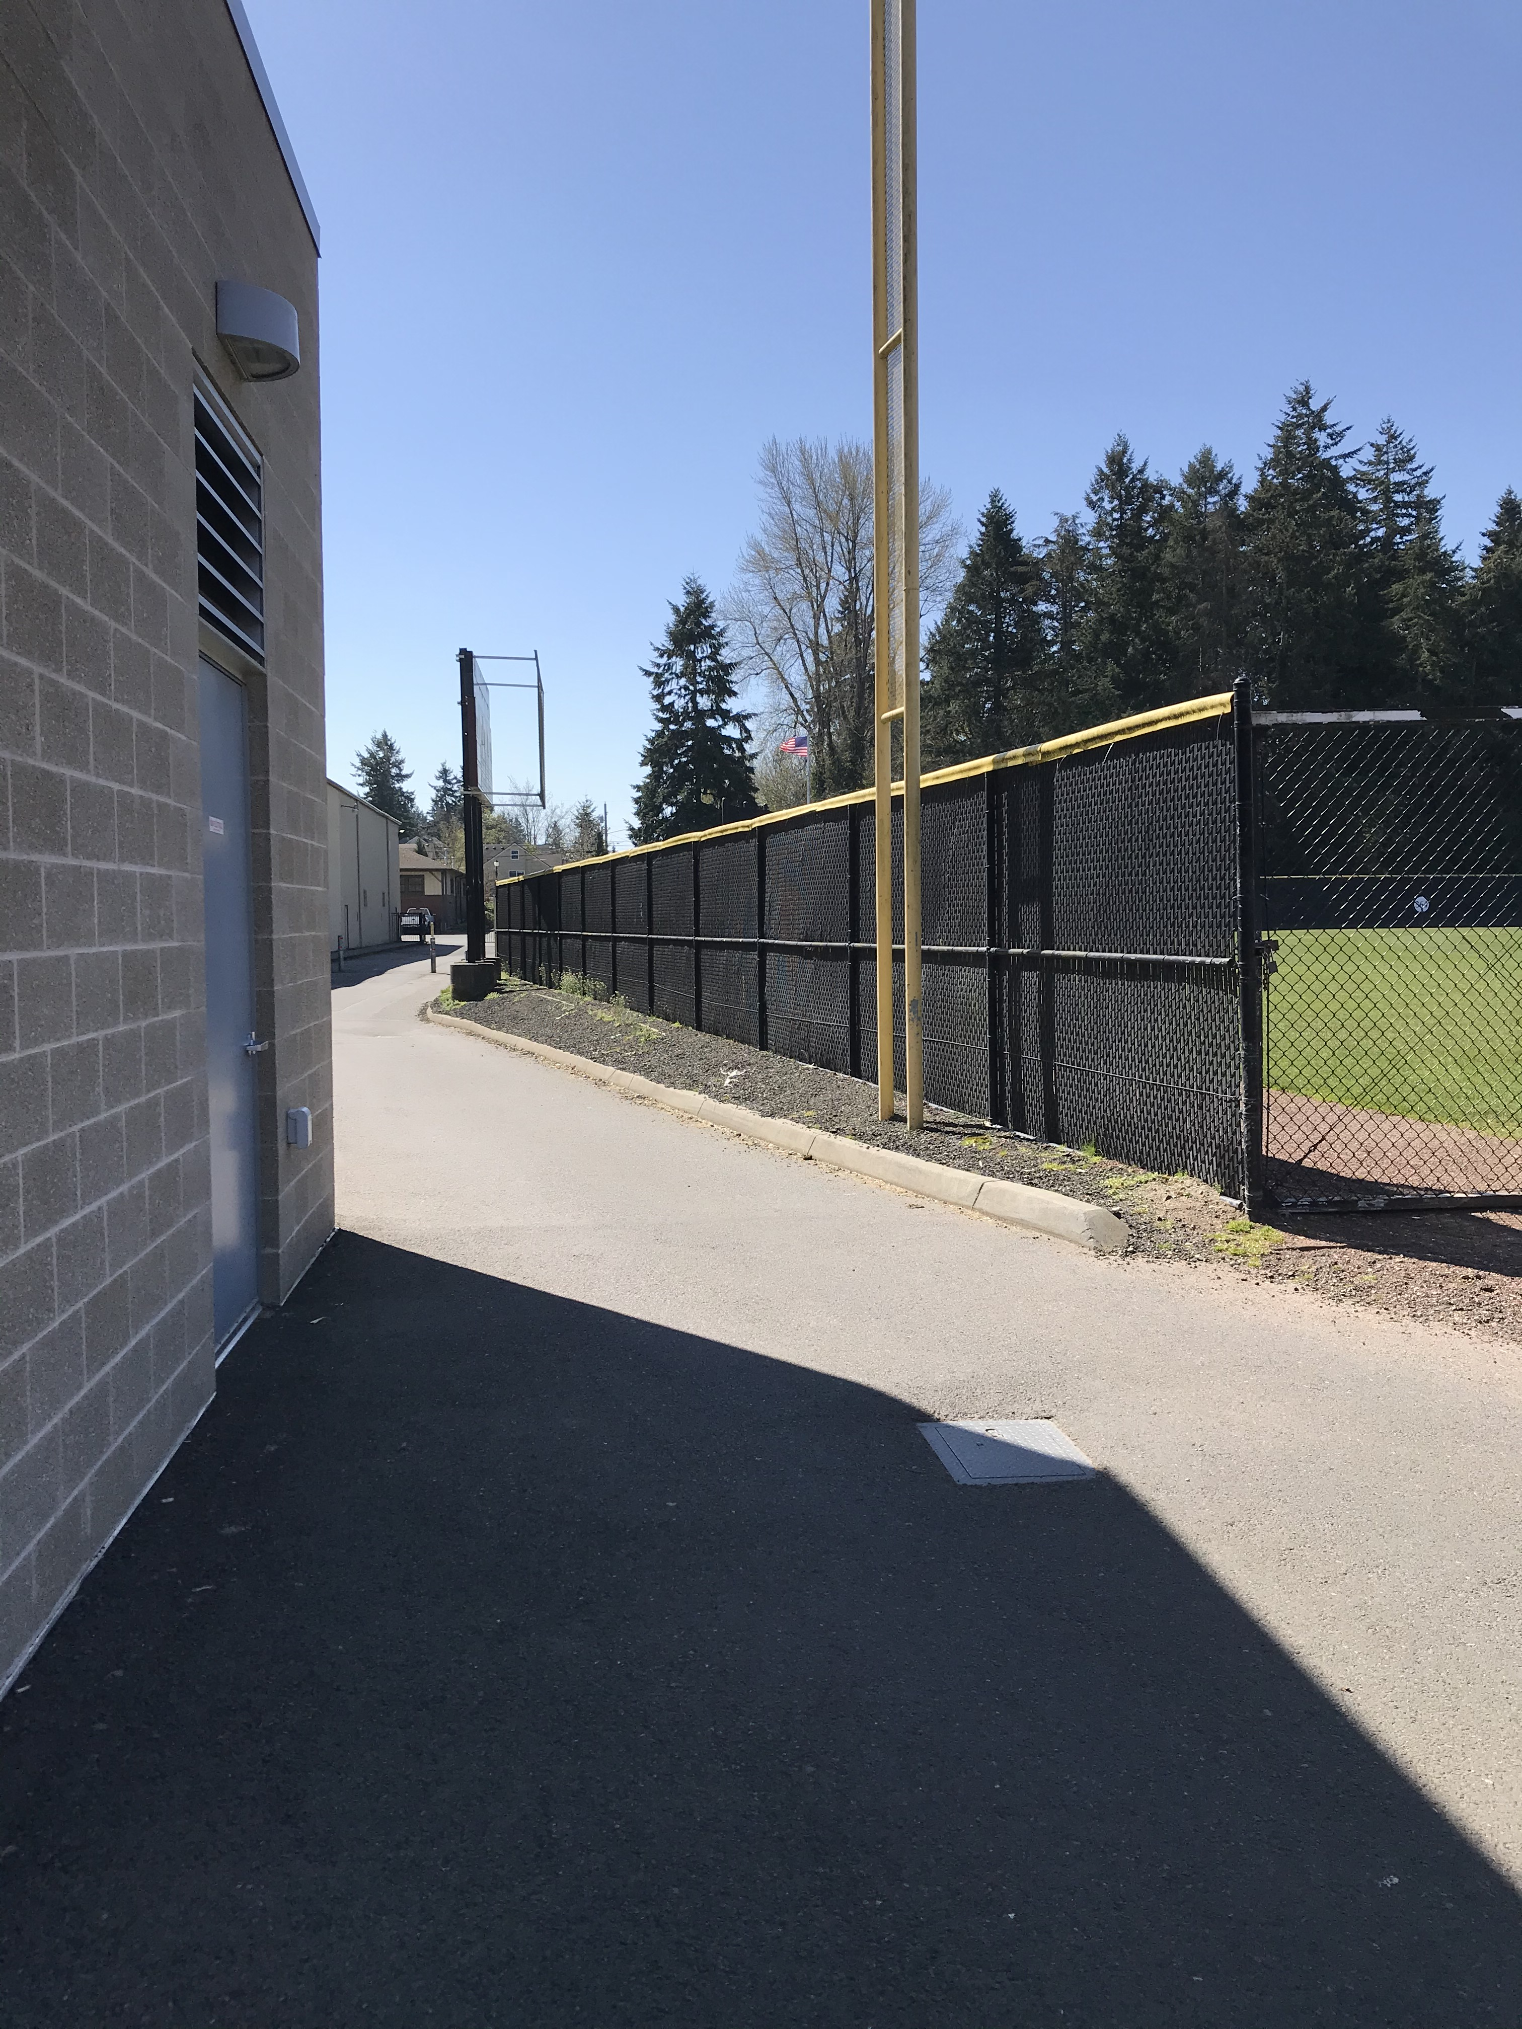
High pedestrian/cart traffic area (west side of aquatics building in between athletics & baseball field)

Slide 12
Stay on sidewalks…DO NOT drive on the streets…
However, you can drive on Lawrence, 13th street, and 15th street (the University owns these roads)

Slide 13
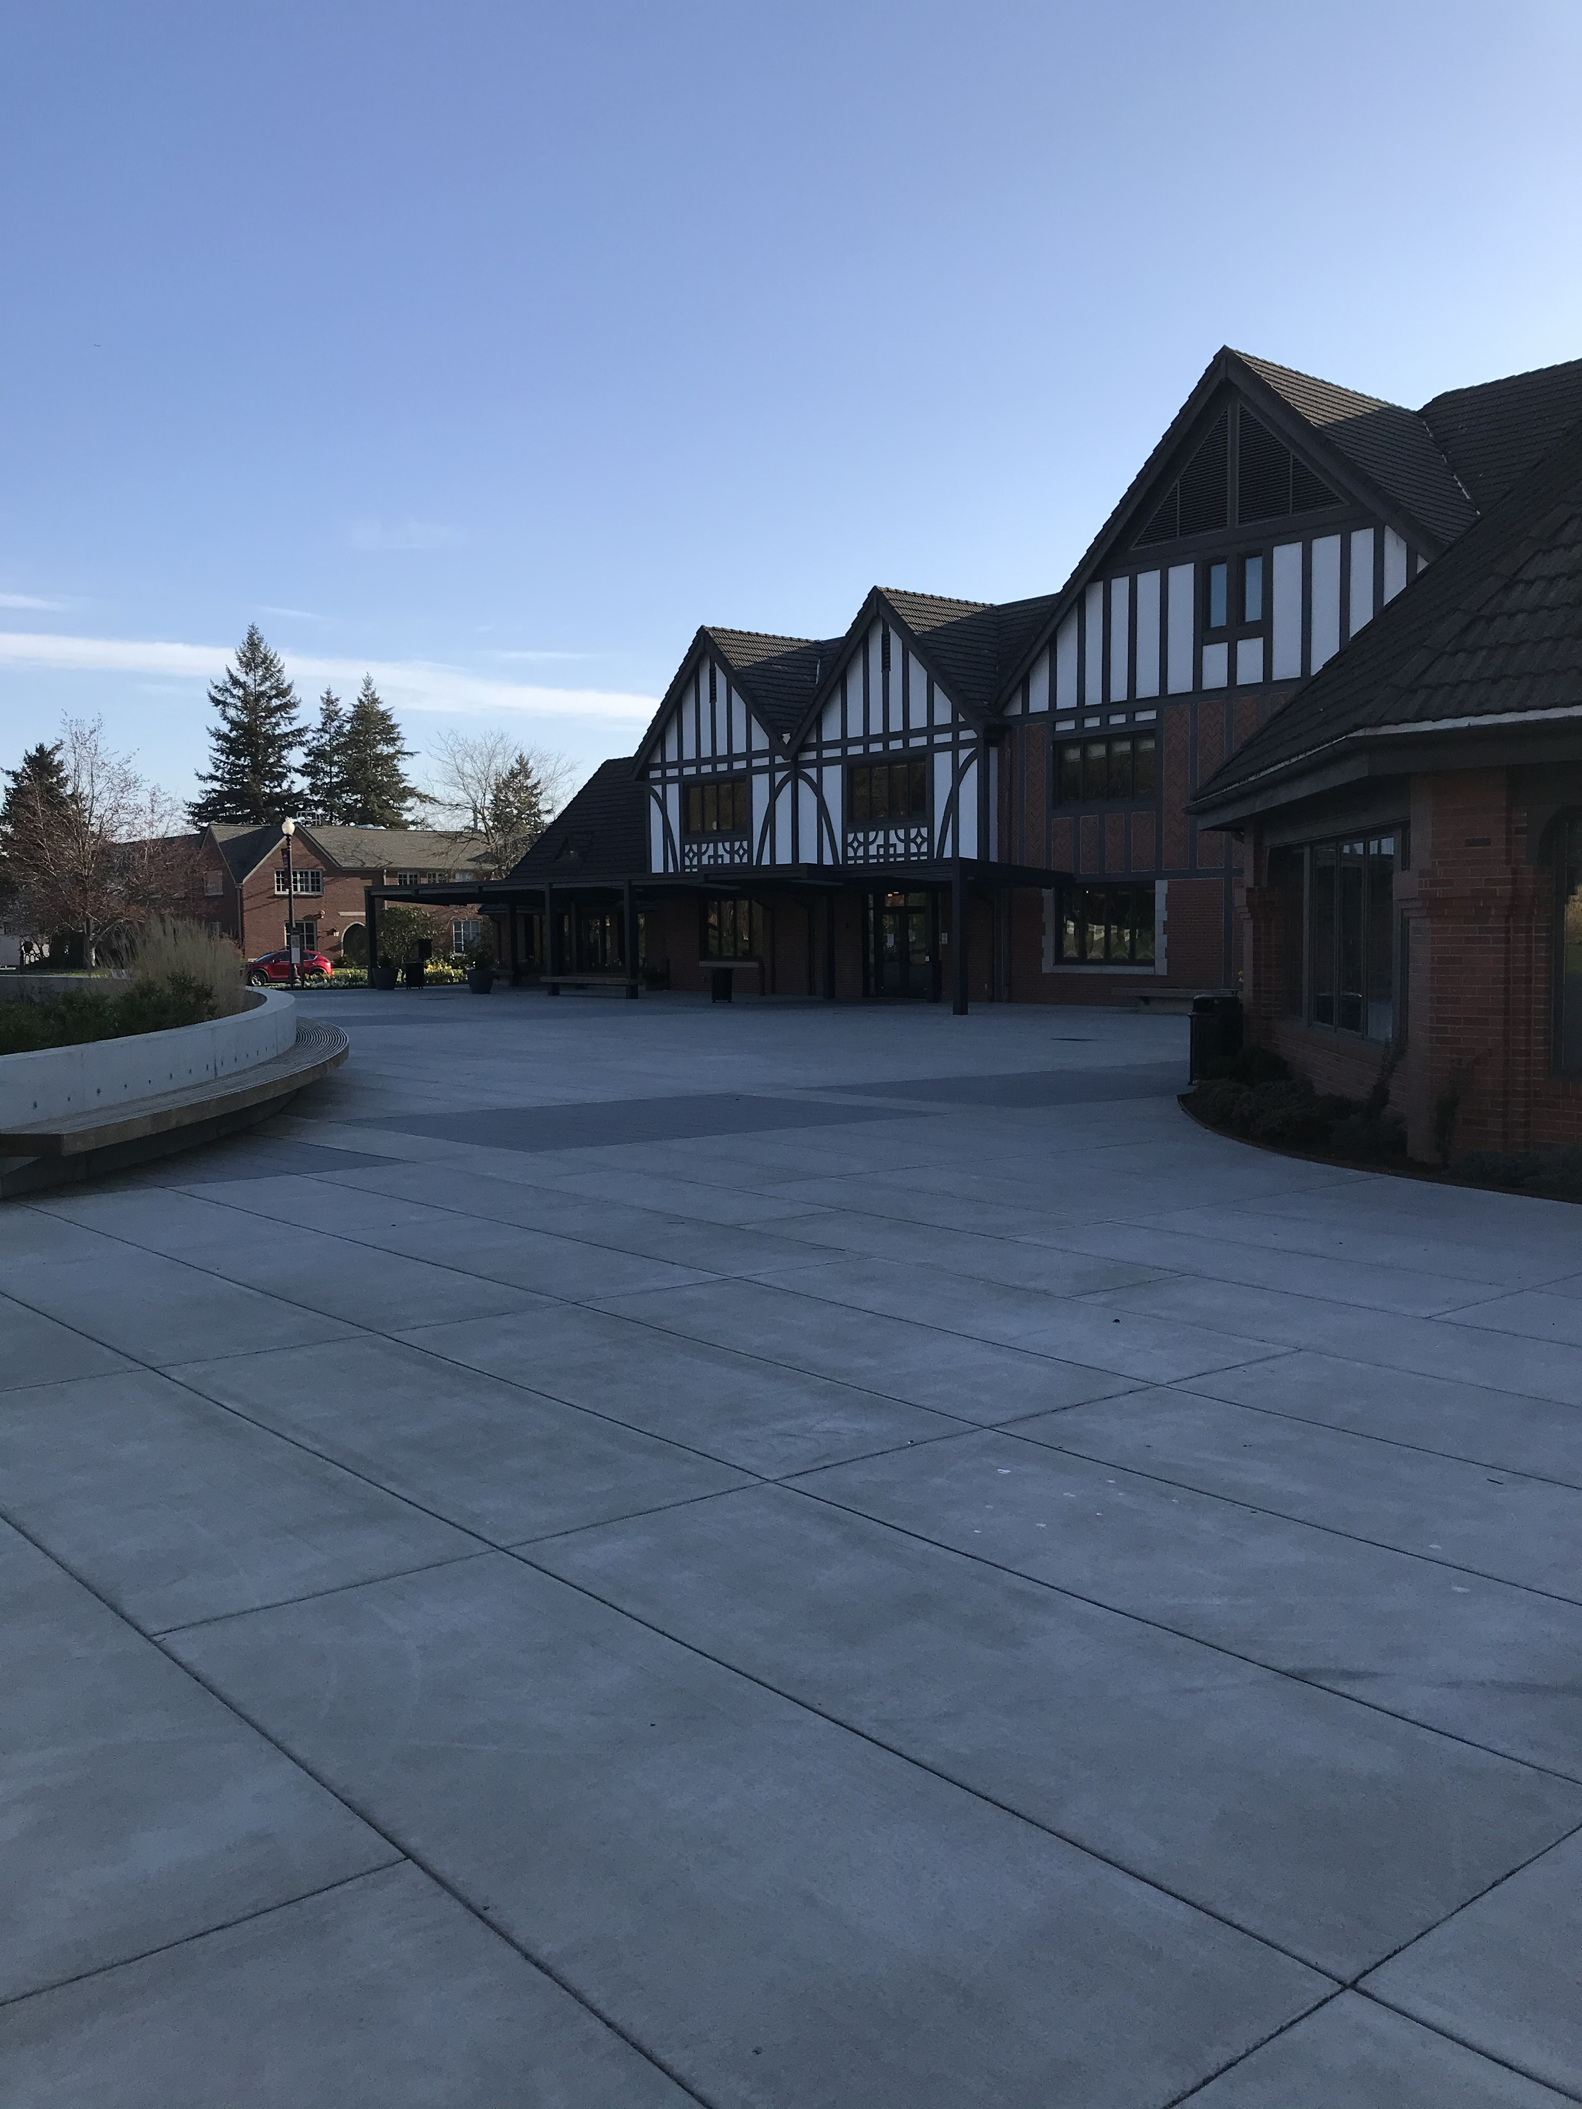
NEVER Drive the Cart through the following areas…
Wheelock Patio

Slide 14
Don’t park in Jones Circle (unless loading & unloading)

Slide 15
Don’t drive through/ or park in Benefactor Plaza

Slide 16
Do not park:
In fire lanes
In front of a building entrance
Disability ramps
In the middle of a path

Slide 18
Pre-Operator Inspection:
Check tires for proper inflation, cuts or punctures
Check for sufficient amount of gas/battery is charged
Check that steering is normal
Check that forward and reverse gears are operational
Check brakes for proper operation

Slide 19
Continued…
If you find any defects, notify your supervisor immediately, and do not operate the cart.

Slide 20
Golf carts are useful tools that help people get from one point to another. However, if used incorrectly, the passengers may fall out of the cart, roll their cart, get run over by a cart or even be struck by the cart.
It is important to remember and to follow all the rules for golf cart safety. This will prevent most (if not all) golf cart accidents.

Slide 21
Any Questions? Next Steps: Please review the non-licensed vehicle operations & guidelines with your supervisor and sign confirmation, hands on training (if applicable),send confirmation sheet to environmental health & safety at znavarrete@pugetsound.edu or mattjohnson@pugetsound.edu

