Slide 1
FISCAL YEAR-END REVIEW
Notes:
Notes have been added to some of the slides to aid with clarification of key points (Angela M)

Slide 2
AGENDA – Fiscal Year End Procedures
Fiscal Year-End Timeline
Budget/Accounting
Accounts Payable
Procurement – What to Know
Procurement Cards – What to Know
FAQ’s

Slide 3
FISCAL YEAR-END TIMELINE
June Deadlines
Review outstanding PeopleSoft open requisitions and open Purchase Orders (POs)
Request assistance from Procurement where open requisitions and POs require attention
Wells Fargo VISA cardholders complete May statement review
Wells Fargo VISA approvers complete May statement approval
Completion Date
June 1
June 2
June 7
June 12
Notes:
Pcard-related dates dictated by Wells Fargo

Slide 4
FISCAL YEAR-END TIMELINE
June Deadlines-continued
All FY21 approved requisitions greater than $1,000, with expected delivery by June 30, sent to Procurement
Submit expense (cash) advance accounting with receipts to A/P
Ensure all petty cash reimbursements are submitted to A/P and picked up as processed
Submit all department deposits to Office of Finance
May Procurement (P-Card) and out of pocket (OOP) transactions posted to PeopleSoft
Completion Date
June 15
June 24
June 25
June 25
June 28
Notes:
PeopleSoft requires receipts to be applied to advances before June 30 in order to post expenses to FY that is ending. AP staff needs time to review, enter, apply, and post these receipts before July starts.

Slide 5
FISCAL YEAR-END TIMELINE
June Deadlines-continued
Submit coded and approved invoices to Accounts Payable (A/P) daily throughout June
Forward PO invoices received by department to A/P
Complete first round review of all budget expenditures in Budget Administration tools
Submit remaining final June deposits
Completion Date
June 30
June 30
June 30
June 30

Slide 6
FISCAL YEAR-END TIMELINE
July Deadlines
Recharge areas submit recharge files/memos to Office of Finance for all goods sold or services provided through June 30
Wells Fargo VISA cardholders complete June statement review
Submit all expense reclassification requests to finance@pugetsound.edu
Submit all FY21 mileage and expense reimbursement requests, other than OOP
Completion Date
July 6
July 7
July 8
July 8
Notes:
June deposits are due June 30 – we give an extra day grace period for final submissions

Slide 7
FISCAL YEAR-END TIMELINE
July Deadlines-continued
Submit all remaining invoices and other disbursement requests to A/P
Facilities submits final utility expense allocation spreadsheet to Office of Finance
Complete second round review of all budget expenditures in Budget Administration tools
Submit expense accrual forms to A/P
Completion Date
July 9
July 9
July 9
July 9

Slide 8
FISCAL YEAR-END TIMELINE
July Deadlines-continued
Wells Fargo VISA approvers complete June statement approval
June P-Card and OOP transactions posted to PeopleSoft
Complete final round review of all budget expenditures in Budget Administration tools
Completion Date
July 12
July 19
July 20

Slide 9
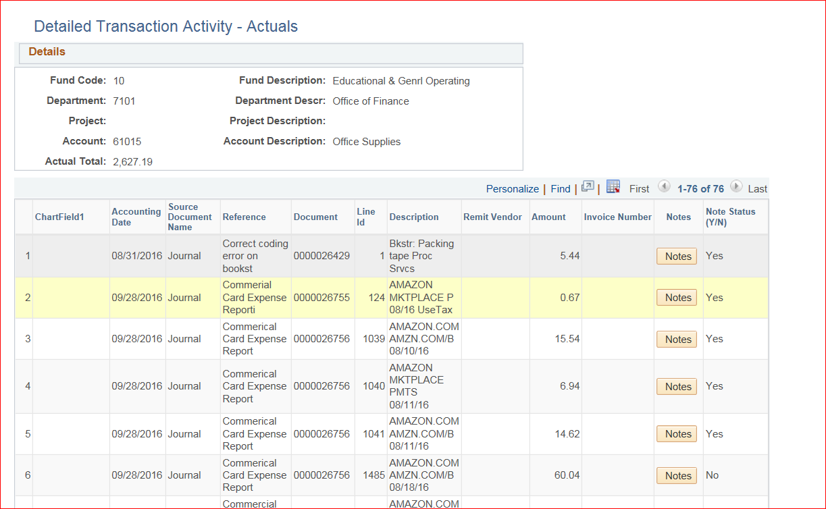
BUDGET – CHECK THOSE TRANSACTIONS
Do you know what is in your budget?
Check each transaction and ensure that this really is an expense that you incurred and should be charged to your budget. If it is not your expense, be sure you ask for a “reclassification” to the correct department or project. Email finance@pugetsound.edu.

Slide 10
ACCRUALS
Have you received an invoice for expenses incurred?
If you have received the goods/services and have started using them before June 30, and have not received an invoice – we need to “accrue” this expense. Call the vendor to receive an invoice. We accrue this expense by making an accounting entry to record the purchase in the correct budget year even though this invoice has not been paid.
Review your contracts for services or other department purchase records to determine if you need to submit an accrual form for outstanding supplier invoices so we can do this accounting entry. Submit accrual form to A/P.

Slide 11
ACCOUNTS PAYABLE - Prepaids
Prepaids are expenses that have been paid but services or items have not been received and placed in service
Travel or cash advances
If travel or other expense occurred by June 30, these are no longer considered advances. Please submit trip report/receipts and coding to Accounts Payable. Advances cannot be charged to departmental budgets until receipts are submitted.
Are you paying for services in advance?
Example – Supplier A bills you for a subscription to a publication that is for the fiscal year 2021-22
Please be sure to enter the correct budget year (‘21-22) on the submitted supplier invoice.

Slide 12
ACCOUNTS PAYABLE
Contact suppliers for outstanding invoices
Check travel or other expense advances
Matching services / goods received dates with correct budget year
Continue to check budget for correct expenses
Use Budget Administration and Purchasing and Payables tools to check for both correct expenses and outstanding invoices.

Slide 13
ACCOUNTS PAYABLE
Petty Cash:
Any disbursement $50 or less is handled through petty cash. These are not expensed (posted to your budget) until the cash is picked up.
Supplier Invoices:
Submit invoices as soon as they are coded and approved.
Please consider using Purchase orders as they encumber your budget as well as keeping the Office of Finance aware of invoices you will be expecting.
Questions?
Please call Wendy at x2732

Slide 14
PROCUREMENT – What to Know
Important Terms / Concepts
Delivery expectations
Receive date
Pre-encumbrance and Encumbrance
Matching requirements – 3-way and 2-way match
Notes:
2-way = Invoice to Purchase Order (if Receiver is not required) ; 3-way = Invoice to Receiver to Purchase Order

Slide 15
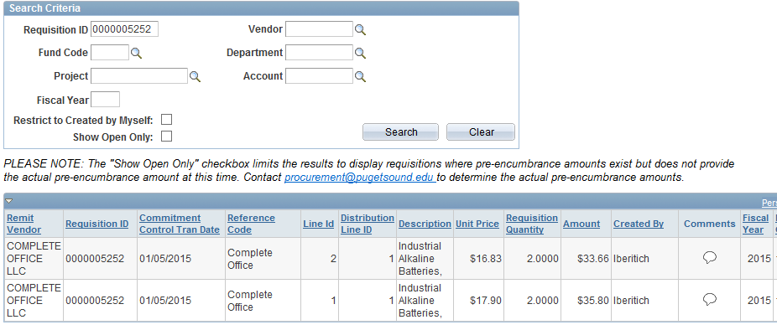
PROCUREMENT – What to Know
Open Requisitions
myPugetSound>Financials>Requisition Inquiry
Pre-Encumbrances created by requisitions
This is relieved when the requisition is converted to a PO
Requisitions that will not be converted to a PO should be CANCELLED
Email procurement@pugetsound.edu or call Procurement at x2731 with questions

Slide 16
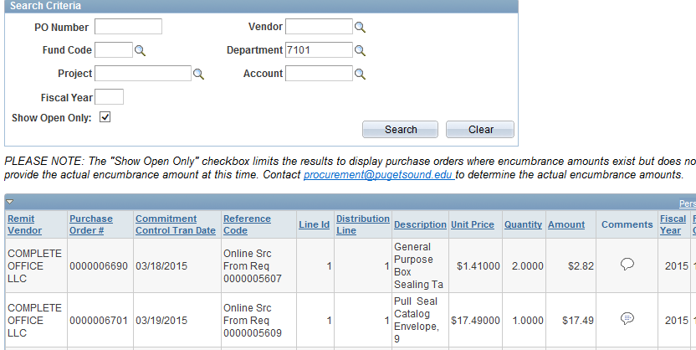
PROCUREMENT – What to Know
Open Purchase Orders
myPugetSound>Financials>Purchase Order Inquiry
Encumbrances created when requisition is converted to PO
This is relieved when the invoice is matched or the balance is finalized
Purchase order balances that are not expected to be delivered or that have been completed should be FINALIZED
Email procurement@pugetsound.edu or call Procurement at x2731 with questions

Slide 17
PROCUREMENT Cards– What to Know
Procurement Card Transactions
Are transactions for goods to be received or services to be rendered in FY21?
YES - expenses will be reflected in current year budget with appropriate expense code
NO - expenses will be treated as prepaid and actually charged to budget in FY22

Slide 18
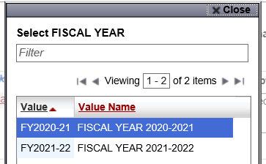
PROCUREMENT CARDS – What to Know
How do I indicate which FY my expense should be in?
What is the cutoff date for June P-Card transactions to be reflected in my June statement?
What if a June transaction is reflected on my July statement instead?
What if I continually need to request reclassifications for P-Card transactions?
Notes:
Cutoff date – Couple of days before June 30 because credit card purchase needs time to post into CCER system (can take 2 to 3 days). June transactions on July statement must be submitted on Accrual Form for FY20. Continual reclasses should consider either adding that speedchart to pcard for cardholder OR do not use pcard for that purchase so that reimbursement request can be routed to appropriate approver.

Slide 19
PROCUREMENT CARDS – What to Know
Critical Processing Dates
May transactions
June 7 - Cardholder/Reconciler completes May reconciliation
June 12 – Approver completes May approval
June 28 – May P-Card and OOP transactions posted to PeopleSoft budgets
June transactions
July 7 – Cardholder/Reconciler completes June reconciliation
July 12 – Approver completes June approval
July 19 – June P-Card and OOP transactions posted to PeopleSoft budgets
Notes:
All pcard-related dates dictated by Wells Fargo (except posting date for June transactions).

Slide 20
PROCUREMENT CARDS – What to Know
If your charge is on an agency speedchart (80XXXX), please change the G/L Code to 22320 every time
If you mark the PERSONAL checkbox on a charge, please also change the G/L Code to 12040 every time
If a charge is for the future fiscal year, please select FY2021-22 for the fiscal year
Purchased gift cards are taxable to faculty and staff, in the same way that a gift of cash would be
If sales tax has not been paid on a tangible item, mark the sales and use tax boxes appropriately

Slide 21
PROCUREMENT CARDS – What to Know
What if I am not available to review and/or approve a P-Card statement during late May, June or July?
NO CHARGES on the statement for May or June - please send an email to finance@pugetsound.edu indicating there will be no charges. Office of Finance will complete the statement on your behalf.

Slide 22
PROCUREMENT CARDS – What to Know
CHARGES in May and/or June – please code all charges in CCER system, gather all receipts and arrange for one of the following options before leaving campus for summer:
Designate someone in your area to reconcile May and/or June statement(s) and give or send your receipts to that delegate. Contact Office of Finance at finance@pugetsound.edu and ask us to ensure this individual has Reconciler privileges to your P-Card in the CCER system.
For academic departments, coordinate with Jan Bartolatz to reconcile the May and/or June statement(s) and give or send your receipts to her at jbartolatz@pugetsound.edu. Contact Office of Finance at finance@pugetsound.edu and ask us to ensure Jan has Reconciler privileges to your P-Card in the CCER system.

Slide 23
RECEIPT/DELIVERY -Unusual Circumstances
If your circumstances involve an unavoidable delay in delivery of furniture or equipment ordered well before June 30, or the unavoidable delay in the start or completion of a construction/renovation project scheduled to conclude by June 30, please contact Budget Analyst Jessica Brown at finance@pugetsound.edu for assistance.
Notes:
Budget Analyst takes to AVP for approval to post to next year’s budget.

Slide 24
FREQUENTLY ASKED QUESTIONS- General/Accounts Payable
Submit general questions and reclassifications to finance@pugetsound.edu.
Please remember to always send A/P and non-A/P reclassification requests in separate emails.
If you have specific questions on accruals or prepaids, please call Wendy Vu at x2732.

Slide 25
FREQUENTLY ASKED QUESTIONS– Accounts Payable
Why do all new suppliers need to submit a W-9?
To perform the appropriate analysis on taxability of transactions for the IRS, Form W-9 is required
IRS Auditors will request documentation
Is there a new mileage rate, and when will it take effect?
The current mileage rate is 56 cents per mile, in use since January 1st, 2021. The IRS has not announced a mid-year revision to this rate.

Slide 26
FREQUENTLY ASKED QUESTIONS - Procurement
How do I find my supplier number?
What is my PO number?
How can I get purchase history information?
Why doesn’t my supplier show up in the drop-down for a requisition?
What do I do if I ordered incorrectly or product is damaged when received?
Who can help me with a chair or other furniture purchase?
How do I gain access for a new requestor in PeopleSoft?
Notes:
Must send email to finance to gain access for new requestor/requisitioner.

Slide 27
FREQUENTLY ASKED QUESTIONS – P-Card
What happens if my card is lost or stolen?
What should the monthly limit for a P-Card be?
How can I have a card limit increased in extenuating circumstances?
Why shouldn’t I be a reconciler and an approver for the same cardholder?

